Slide 1

PowerShell & DEVOPS User Group
Scotland 21/06/2017
@ScotPSUG

Slide 2
agenda!
7.00pm – Waiting room for general chit chat
7.10pm – Welcome, introductions and agenda (Paul Broadwith @pauby)
7.20pm – Learn PowerShell In A Month Of Lunches (Colin Westwater @cwestwater)
7.40pm – Advanced Functions & Modules For The Real World (Paul Broadwith @pauby)
8.40pm – Wrap up / Close
@ScotPSUG

Slide 3

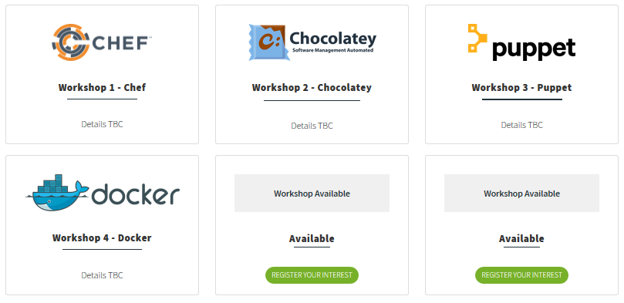
events
WinOps 2017
Wed 20th – Thur 21st September
http://winops.org
@ScotPSUG

Slide 4

Powershell News!
PowerShell v6 Beta 1
PowerShell + DevOps Global Summit 2017
VS Code PowerShell extension reached version 1.0
Azure Cloud Shell – PowerShell version in preview
http://aka.ms/pscloudsignup
@ScotPSUG

Slide 5
We need
Speakers
Some lined up, discussions ongoing
A venue
At least one person to help me run the group
@ScotPSUG

Slide 6


Join the PSUG Slack TEAM
We’re here:
https://get-psuguk.herokuapp.com
Or
http://bit.ly/2eQyxOD
@ScotPSUG

